Slide 1


Slide 2
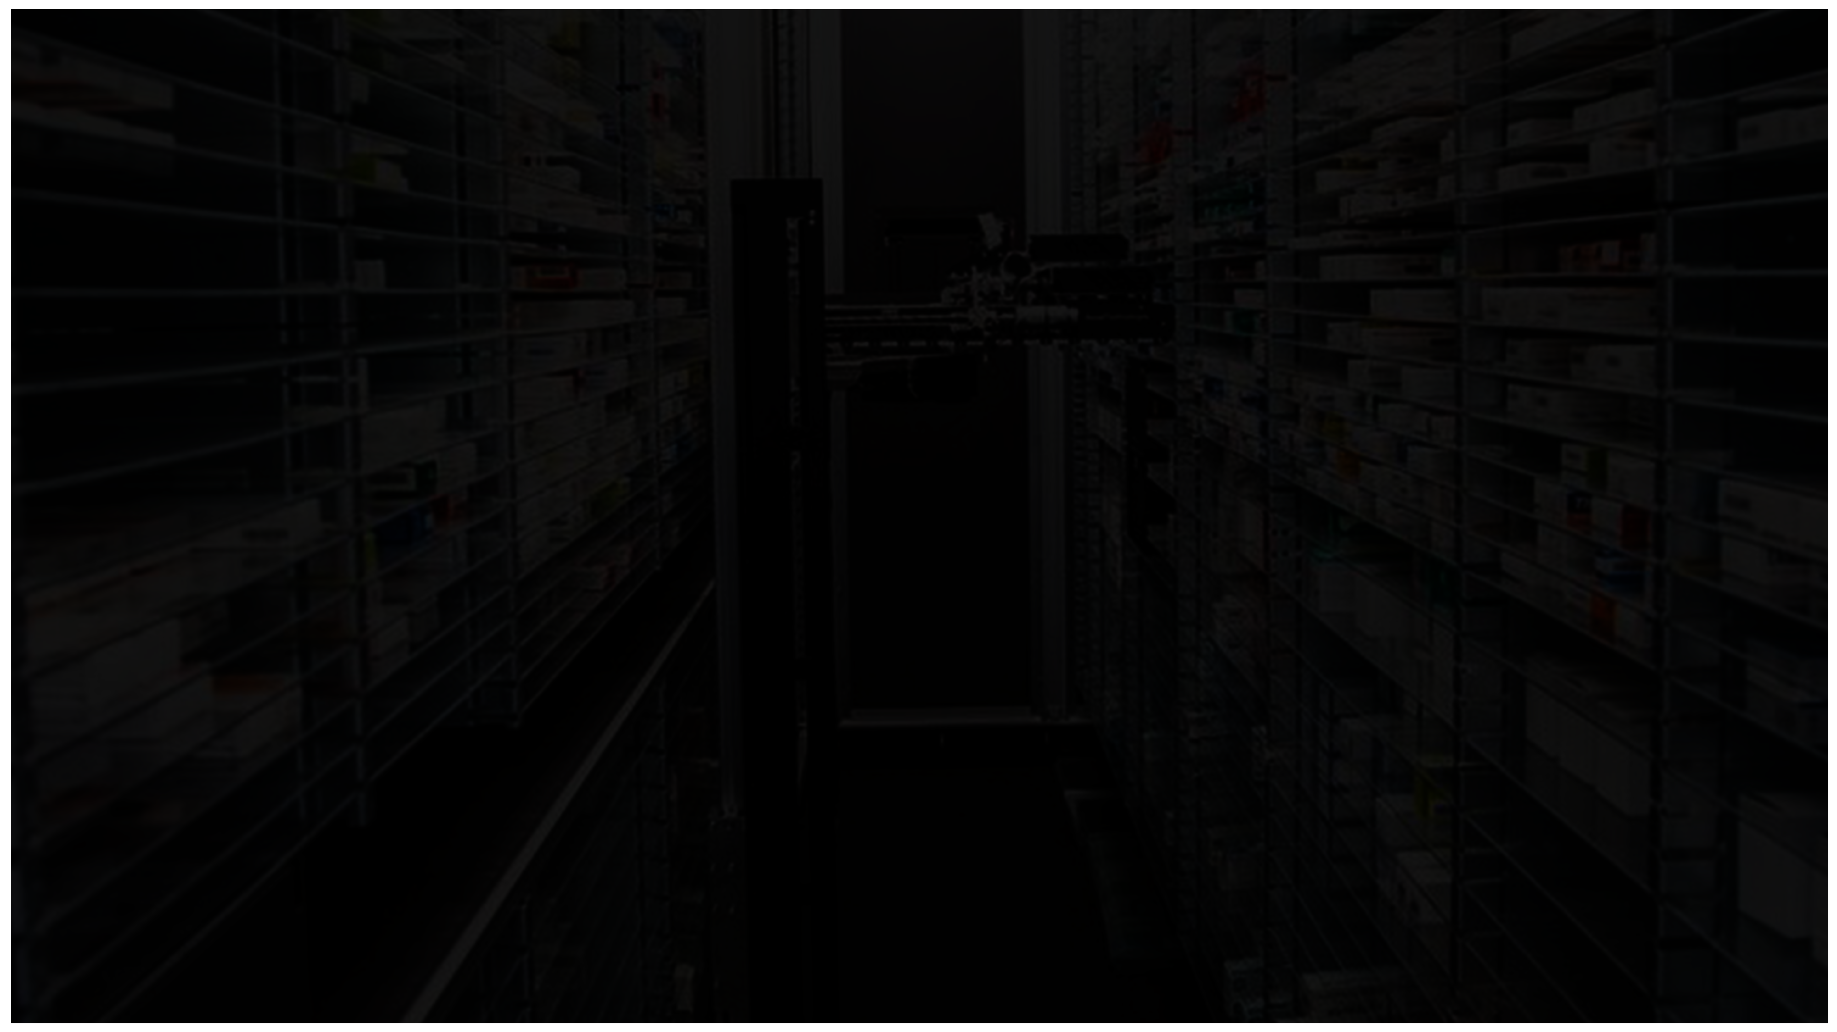

Supervisors
Prof / Randa Mohammed
TA / Fatma Gamal
Computer Systems Department

Slide 3
Team [8] Members
Abdullah Waleed Saied
Mohamed Ahmed Mohamed Zakaria
Omar Mohamed Salah
Omar Shreif Elsayed
Sohayla Saied Hassan Shedeed
Zeyad Atef Shokry

Slide 4
Agenda
Introduction
Important Questions To Ask
Problem Statement
Objectives
Related Work & Applications
System Architecture
Possible Techniques
Conclusion
Tools
Time plan
References

Slide 5

Introduction
Pharmacy automation has existed since the 1960’s.
pharmacy automation includes: (Dispensing Robots, Prescription Reordering Apps, Electronic CD Registers,…).
pharmacy automation was classified in 5 Levels.

Slide 6
Important Questions To Ask
What does automating mean for a pharmacy?
What is the first place in pharmacy where automation should start?
Can the role of a pharmacist be automated?
Does automating mean fewer employees in the pharmacy?

Slide 7
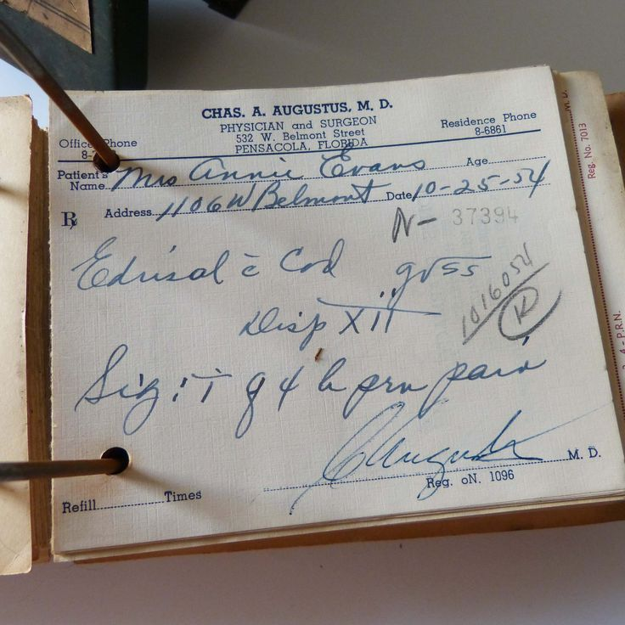
Problem Statement

Slide 8
Problem Statement
Doctors' sloppy handwriting kills more than 7,000 people annually.
according to a July 2006 report from the National Academies of Science's Institute of Medicine (IOM), preventable medication mistakes also injure more than 1.5 million Americans annually.
illegible writing on some of the 3.2 billion prescriptions written in the U.S. every year.
[Cause of Death: Sloppy Doctors]
By Jeremy Caplan Monday, Jan. 15, 2007

Slide 9
Objectives
Make the pharmacy almost fully automated
Speeding up the process of purchasing medicines through our High-Speed Dispensing Robot
Make the prescription , CD registers and all inventory documents Electronic through our Desktop Application
Tracking and predicting medicine consumption through our Machine-Learning Model

Slide 10
Related Works & Applications

Slide 11

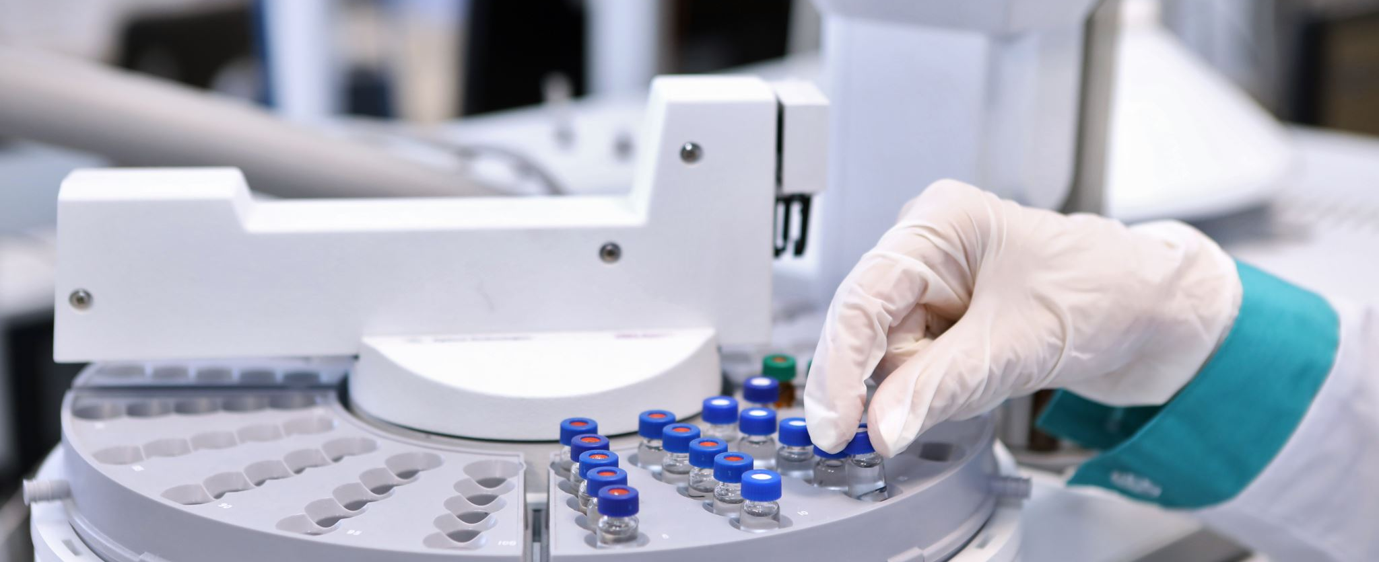
Initiation of the First Smart Pharmacy
The first smart pharmacy was launched in Dubai in 2017. The pharmacy uses a robotic dispensing system that can fill prescriptions in as little as 15 seconds. The system is also able to track the inventory of medication and alert the staff when it is low.

Slide 12
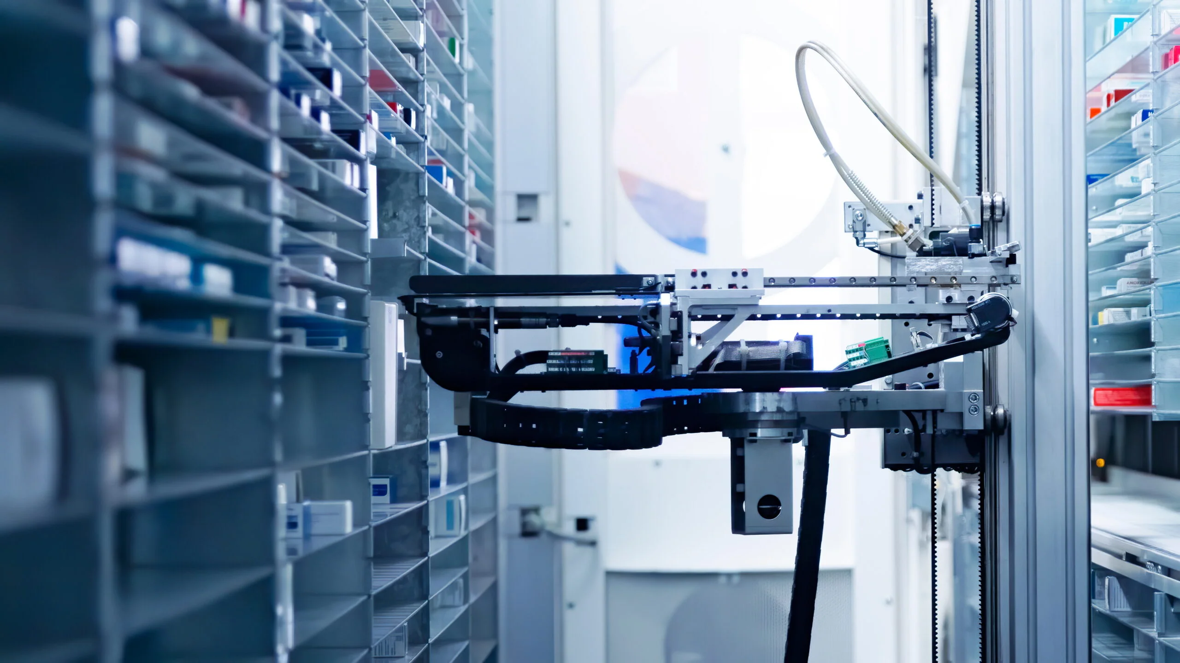
Implementation and Impact
The implementation of smart pharmacy technology has had several positive impacts on patient care ,which can lead to better health outcomes.
Statistics:
Smart pharmacies can reduce medication errors by up to 50%.
95% of patients were satisfied with the speed and accuracy of the service.

Slide 13
King Faisal Specialist Hospital, Saudi Arabia Comprehensive Approach: Robotic dispensing, adherence, patient monitoring Results: 20% error reduction, 5% improved safety, 10% adherence, 3% fewer readmissions
Smart Pharmacy Systems: A Comparative Overview
Al Zahra Hospital Pharmacy, Dubai
Inventory Management: Real-time tracking to prevent shortages Outcomes: Reduced medication errors by 50%, 20% improvement in safety, 15% increased satisfaction
Hamad Medical Corporation Pharmacy, Qatar
Holistic System: Robotic dispensing, tracking,
patient education Improvements: 30% fewer errors, 10% better safety,
5% enhanced adherence
Cleveland Clinic Abu Dhabi Pharmacy, UAE
Integrated System: Robotic dispensing, tracking, patient education Achievements: 10% fewer errors, 3% enhanced safety, 8% increased satisfaction

Slide 14
Kafr-Elsheikh University

Slide 15
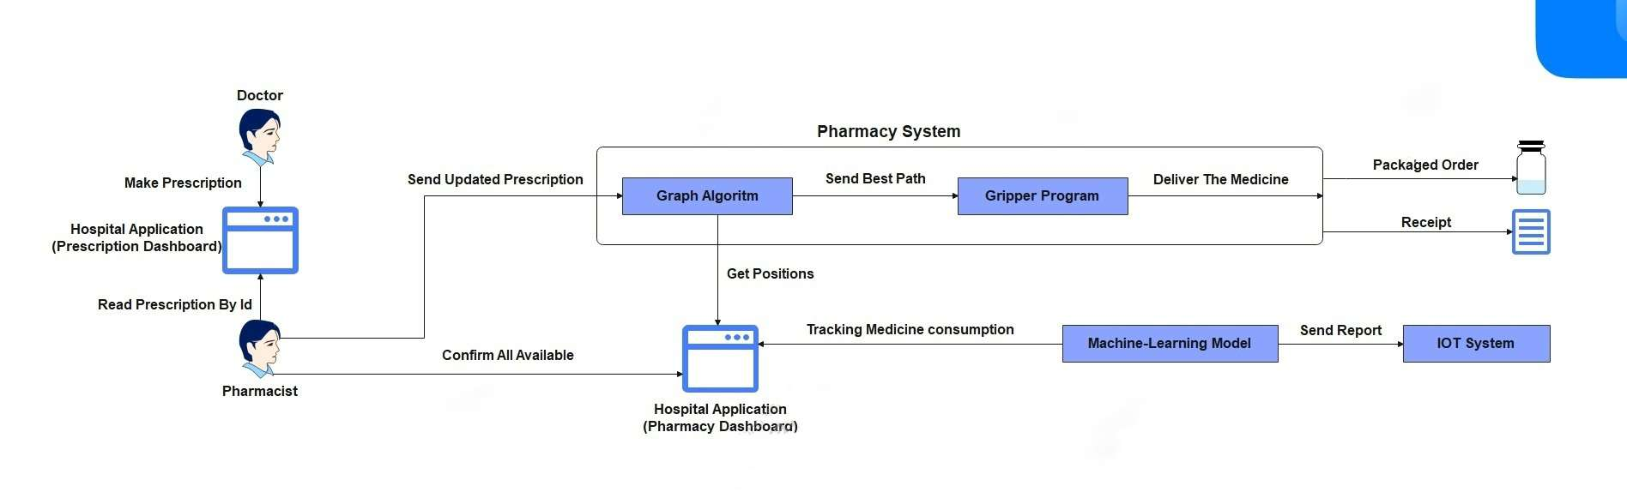

System Architecture [Phase diagram]

Slide 16

Possible Techniques
Software
1. Graph Algorithm
2. Desktop Application
3. Database
4. Machine Learning
5. IOT

Slide 17
Graph Algorithm
Features | BFS | A*
Graph type | Unweighted | Weighted or unweighted
Path type | Shortest path | Shortest or minimum cost path
Efficiency | Simple, but less efficient in large graphs | More efficient, especially with a good heuristic
Complexity | O(V + E) | O(|V| log(|V|) + |E|)
Heuristic function | Not applicable | Required for effective path guidance

Slide 18



Desktop Application
Windows Forms
PyQT
PySide

Slide 19

Database
MySQL

Slide 20
Database
Utilizing a local database server, such as MySQL, presents an advantageous solution for managing doctors' information and medicine inventory.
The proximity of these data sets within the same network eliminates the necessity for a global database. Leveraging a local server streamlines data management, ensuring efficient access and control while optimizing network resources.
MySQL

Slide 21

Machine Learning

Slide 22
Machine Learning
A machine learning model trained on historical patient data will predict future medication consumption patterns. This predictive capability will inform inventory management strategies and optimize procurement processes, ensuring adequate stock levels. we have two models:
Reinforcement
Supervised

Slide 23

IOT

Slide 24
IOT
Our approach involves receiving reports from a machine learning model to identify medicines with high consumption, optimizing ordering processes to avoid unnecessary surplus. For transmitting these orders, we've identified two network protocols:
SMTP (Simple Mail Transfer Protocol).
MQTT (Message Queuing Telemetry Transport).

Slide 25
Possible Techniques
Hardware
Reaching Medicine Position Phase:
1. Ball Screw Slider
2. Belt Driven Slider
Gripping Medicine Phase:
1. Gripper With Worm Gears
2. Robot Servo Motor Gripper

Slide 26
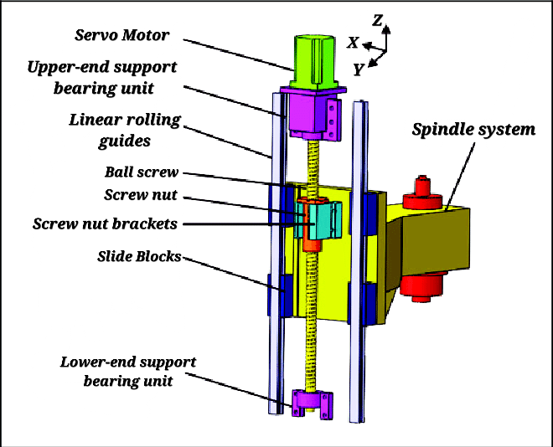
Reaching Medicine Position Phase

Slide 27
Reaching Medicine Position Phase
Ball Screw Slider
Advantages :
High efficiency, exceeding 90%.
Excellent precision and accuracy for precise linear motion control.
High load capacity, capable of handling heavy loads.
Long service life due to reduced wear and tear.
ball screw slider are often seen as safer than belt drives for carrying vertical loads.

Slide 28
Reaching Medicine Position Phase
Ball Screw Slider
Disadvantages:
Higher cost compared to other linear motion systems.
Requires periodic maintenance and lubrication.
Limited speed capabilities, not suitable for high-speed applications.
Sensitivity to misalignment, requiring proper alignment and regular checks.

Slide 29
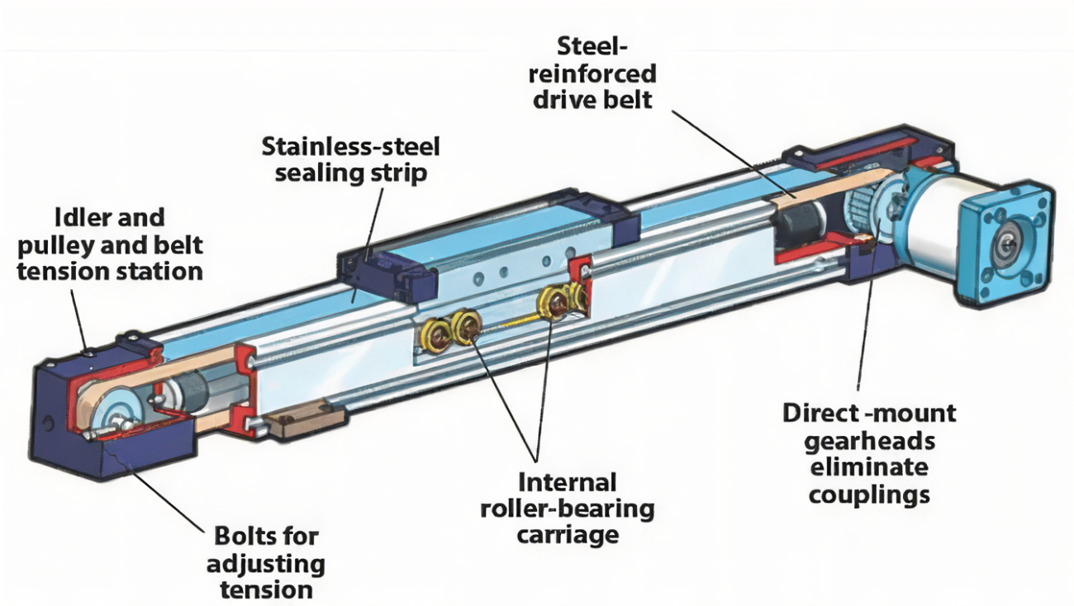
Reaching Medicine Position Phase

Slide 30
Reaching Medicine Position Phase
Belt Driven Slider
Advantages:
Cost-effective compared to other linear motion systems.
Well-suited for high-speed applications.
Low maintenance requirements.
Quieter operation compared to systems with direct contact.

Slide 31
Reaching Medicine Position Phase
Belt Driven Slider
Disadvantages:
Lower precision and accuracy compared to other systems.
Occasional belt maintenance or replacement may be required.

Slide 32
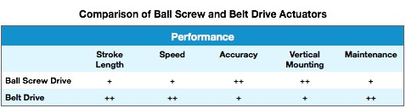
Reaching Medicine Position Phase
Ball Screw Slider VS Belt Driven Slider

Slide 33
Possible Techniques
Hardware
Reaching Medicine Position Phase:
1. Ball Screw Slider
2. Belt Driven Slider
Gripping Medicine Phase:
1. Gripper With Worm Gears
2. Robot Servo Motor Gripper

Slide 34
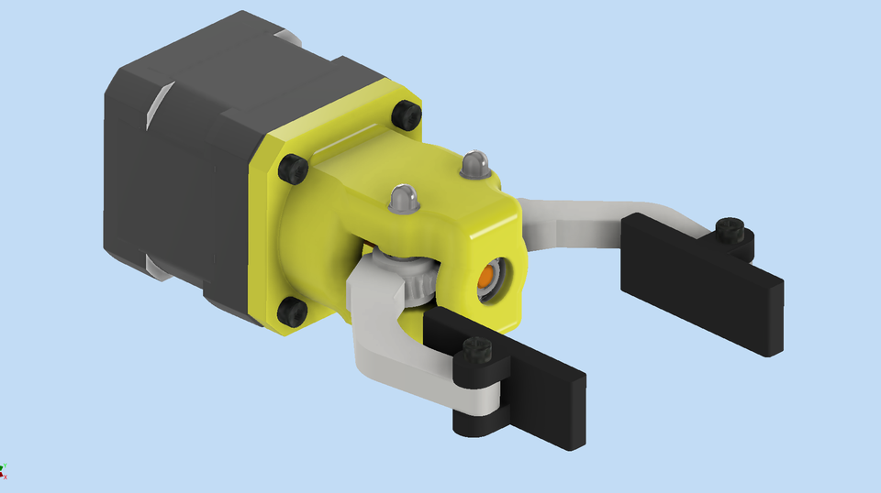
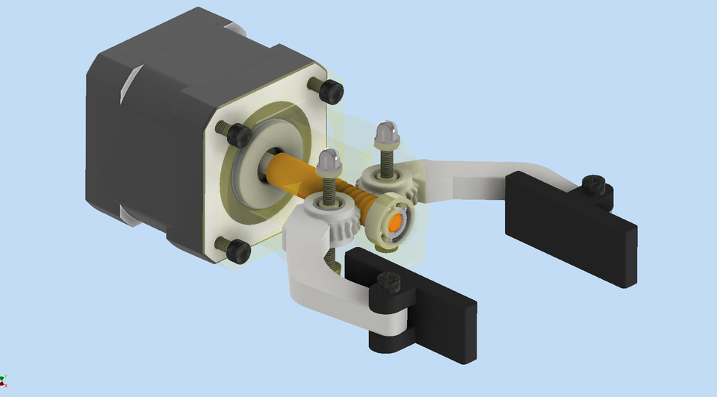
Gripping Medicine Phase
Notes:
Advantages:
High Torque and Precision: Worm gears provide high torque, allowing robotic grippers to exert strong forces when needed. This high torque capability enhances the precision and reliability of gripping actions.
Self-Locking Feature: Worm gears have a self-locking characteristic, meaning that the gripper can maintain a stable position without the need for additional braking mechanisms. This feature is advantageous in applications where the gripper must hold a position without continuous power input.
Compact Design: Worm gears are known for their compact design, making them suitable for applications where space is limited. Robotic grippers with worm gears can be designed to fit into tight spaces without compromising functionality.
Reduced Backlash: Worm gears can exhibit lower backlash compared to some other gear types. This reduced backlash contributes to improved accuracy in the gripping and positioning tasks of the robotic system.
High Efficiency: Worm gears can achieve high efficiency in power transmission, leading to less energy consumption and minimizing heat generation during operation. This is particularly advantageous for robotic systems aiming for energy efficiency.
Disadvantages:
Limited Speed: Worm gears are generally not designed for high-speed applications. The nature of the gear mechanism can result in slower rotational speeds compared to other gear types, which may be a limitation in applications requiring rapid movements.
Efficiency Variability: While worm gears can be highly efficient in specific operating conditions, their efficiency may vary based on factors such as the lead angle and gear ratio. This variability can be a consideration in applications where consistent efficiency is critical.
Back-Driving Difficulty: The self-locking feature of worm gears, while advantageous for stability, can make it challenging to back-drive the system. In some applications, the inability to easily move the gripper manually may be a drawback.
Higher Friction: Worm gears can exhibit higher friction compared to certain other gear types. This increased friction may result in more wear and tear over time, impacting the overall lifespan of the gripper.

Slide 35
Gripping Medicine Phase
Gripper With Worm Gears
Advantages:
High Torque and Precision.
Self-Locking Feature.
Compact Design.
Reduced Backlash.
High Efficiency.
Notes:
Advantages:
High Torque and Precision: Worm gears provide high torque, allowing robotic grippers to exert strong forces when needed. This high torque capability enhances the precision and reliability of gripping actions.
Self-Locking Feature: Worm gears have a self-locking characteristic, meaning that the gripper can maintain a stable position without the need for additional braking mechanisms. This feature is advantageous in applications where the gripper must hold a position without continuous power input.
Compact Design: Worm gears are known for their compact design, making them suitable for applications where space is limited. Robotic grippers with worm gears can be designed to fit into tight spaces without compromising functionality.
Reduced Backlash: Worm gears can exhibit lower backlash compared to some other gear types. This reduced backlash contributes to improved accuracy in the gripping and positioning tasks of the robotic system.
High Efficiency: Worm gears can achieve high efficiency in power transmission, leading to less energy consumption and minimizing heat generation during operation. This is particularly advantageous for robotic systems aiming for energy efficiency.
Disadvantages:
Limited Speed: Worm gears are generally not designed for high-speed applications. The nature of the gear mechanism can result in slower rotational speeds compared to other gear types, which may be a limitation in applications requiring rapid movements.
Efficiency Variability: While worm gears can be highly efficient in specific operating conditions, their efficiency may vary based on factors such as the lead angle and gear ratio. This variability can be a consideration in applications where consistent efficiency is critical.
Back-Driving Difficulty: The self-locking feature of worm gears, while advantageous for stability, can make it challenging to back-drive the system. In some applications, the inability to easily move the gripper manually may be a drawback.
Higher Friction: Worm gears can exhibit higher friction compared to certain other gear types. This increased friction may result in more wear and tear over time, impacting the overall lifespan of the gripper.

Slide 36
Gripping Medicine Phase
Gripper With Worm Gears
Disadvantages:
Limited Speed.
Efficiency Variability.
Back-Driving Difficulty.
Higher Friction.
Notes:
Advantages:
High Torque and Precision: Worm gears provide high torque, allowing robotic grippers to exert strong forces when needed. This high torque capability enhances the precision and reliability of gripping actions.
Self-Locking Feature: Worm gears have a self-locking characteristic, meaning that the gripper can maintain a stable position without the need for additional braking mechanisms. This feature is advantageous in applications where the gripper must hold a position without continuous power input.
Compact Design: Worm gears are known for their compact design, making them suitable for applications where space is limited. Robotic grippers with worm gears can be designed to fit into tight spaces without compromising functionality.
Reduced Backlash: Worm gears can exhibit lower backlash compared to some other gear types. This reduced backlash contributes to improved accuracy in the gripping and positioning tasks of the robotic system.
High Efficiency: Worm gears can achieve high efficiency in power transmission, leading to less energy consumption and minimizing heat generation during operation. This is particularly advantageous for robotic systems aiming for energy efficiency.
Disadvantages:
Limited Speed: Worm gears are generally not designed for high-speed applications. The nature of the gear mechanism can result in slower rotational speeds compared to other gear types, which may be a limitation in applications requiring rapid movements.
Efficiency Variability: While worm gears can be highly efficient in specific operating conditions, their efficiency may vary based on factors such as the lead angle and gear ratio. This variability can be a consideration in applications where consistent efficiency is critical.
Back-Driving Difficulty: The self-locking feature of worm gears, while advantageous for stability, can make it challenging to back-drive the system. In some applications, the inability to easily move the gripper manually may be a drawback.
Higher Friction: Worm gears can exhibit higher friction compared to certain other gear types. This increased friction may result in more wear and tear over time, impacting the overall lifespan of the gripper.

Slide 37
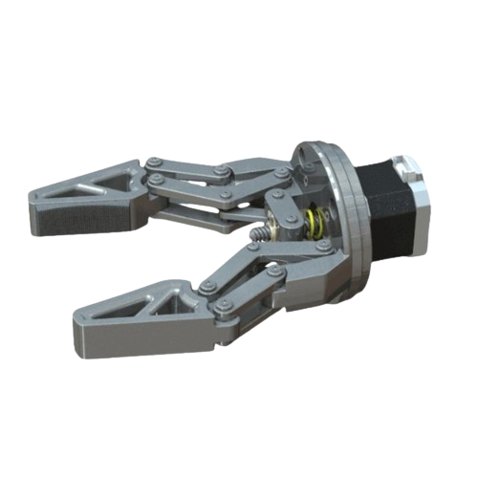
Gripping Medicine Phase
Notes:
Advantages:
High Torque and Precision: Worm gears provide high torque, allowing robotic grippers to exert strong forces when needed. This high torque capability enhances the precision and reliability of gripping actions.
Self-Locking Feature: Worm gears have a self-locking characteristic, meaning that the gripper can maintain a stable position without the need for additional braking mechanisms. This feature is advantageous in applications where the gripper must hold a position without continuous power input.
Compact Design: Worm gears are known for their compact design, making them suitable for applications where space is limited. Robotic grippers with worm gears can be designed to fit into tight spaces without compromising functionality.
Reduced Backlash: Worm gears can exhibit lower backlash compared to some other gear types. This reduced backlash contributes to improved accuracy in the gripping and positioning tasks of the robotic system.
High Efficiency: Worm gears can achieve high efficiency in power transmission, leading to less energy consumption and minimizing heat generation during operation. This is particularly advantageous for robotic systems aiming for energy efficiency.
Disadvantages:
Limited Speed: Worm gears are generally not designed for high-speed applications. The nature of the gear mechanism can result in slower rotational speeds compared to other gear types, which may be a limitation in applications requiring rapid movements.
Efficiency Variability: While worm gears can be highly efficient in specific operating conditions, their efficiency may vary based on factors such as the lead angle and gear ratio. This variability can be a consideration in applications where consistent efficiency is critical.
Back-Driving Difficulty: The self-locking feature of worm gears, while advantageous for stability, can make it challenging to back-drive the system. In some applications, the inability to easily move the gripper manually may be a drawback.
Higher Friction: Worm gears can exhibit higher friction compared to certain other gear types. This increased friction may result in more wear and tear over time, impacting the overall lifespan of the gripper.

Slide 38
Gripping Medicine Phase
Servo Motor Gripper
Advantages:
Precision Control.
Variable Speeds.
Programmability.
Back-Driving Capability.
High Torque.
Notes:
Advantages:
Precision Control: Servo motor grippers offer precise control over position, speed, and force. This level of precision is crucial in applications that require accurate and repeatable gripping actions.
Variable Speeds: These grippers can achieve a wide range of speeds, providing flexibility for applications that involve both high-speed and low-speed operations. The variable speed capability allows for adaptability to different tasks.
Programmability: Servo motor grippers are programmable, allowing for the customization of gripping profiles, force feedback, and motion sequences. This makes them versatile and suitable for a variety of applications with different requirements.
Back-Driving Capability: Unlike some other gripper types, servo motor grippers can be designed to allow controlled back-driving. This enables manual adjustments or repositioning of the gripper when needed, adding flexibility to the system.
High Torque: Servo motors can provide high torque, ensuring strong gripping forces when necessary. This is advantageous in applications that involve handling heavier loads or materials.
Disadvantages:
Complexity: Servo motor grippers can be more complex than some other gripper types, requiring a higher level of technical expertise for installation, programming, and maintenance.
Cost: The precision and advanced capabilities of servo motor grippers often come at a higher cost compared to simpler gripper technologies. Initial investment and maintenance expenses may be a consideration.
Power Consumption: While modern servo motors are designed for efficiency, they may still consume more power compared to certain other gripper types. This is a factor to consider, especially in applications where energy efficiency is a priority.
Size and Weight: Servo motors and associated control systems may add bulk and weight to the gripper assembly. In applications where space and weight constraints are critical, this can be a drawback.

Slide 39
Gripping Medicine Phase
Servo Motor Gripper
Disadvantages:
Complexity.
Cost.
Power Consumption.
Size and Weight.
Notes:
Advantages:
Precision Control: Servo motor grippers offer precise control over position, speed, and force. This level of precision is crucial in applications that require accurate and repeatable gripping actions.
Variable Speeds: These grippers can achieve a wide range of speeds, providing flexibility for applications that involve both high-speed and low-speed operations. The variable speed capability allows for adaptability to different tasks.
Programmability: Servo motor grippers are programmable, allowing for the customization of gripping profiles, force feedback, and motion sequences. This makes them versatile and suitable for a variety of applications with different requirements.
Back-Driving Capability: Unlike some other gripper types, servo motor grippers can be designed to allow controlled back-driving. This enables manual adjustments or repositioning of the gripper when needed, adding flexibility to the system.
High Torque: Servo motors can provide high torque, ensuring strong gripping forces when necessary. This is advantageous in applications that involve handling heavier loads or materials.
Disadvantages:
Complexity: Servo motor grippers can be more complex than some other gripper types, requiring a higher level of technical expertise for installation, programming, and maintenance.
Cost: The precision and advanced capabilities of servo motor grippers often come at a higher cost compared to simpler gripper technologies. Initial investment and maintenance expenses may be a consideration.
Power Consumption: While modern servo motors are designed for efficiency, they may still consume more power compared to certain other gripper types. This is a factor to consider, especially in applications where energy efficiency is a priority.
Size and Weight: Servo motors and associated control systems may add bulk and weight to the gripper assembly. In applications where space and weight constraints are critical, this can be a drawback.

Slide 40
Gripping Medicine Phase
Common Disadvantages:
Needs slider to move in z-axis.
Needs Block and guider with slider
Extra cost with slider
Notes:
Advantages:
Precision Control: Servo motor grippers offer precise control over position, speed, and force. This level of precision is crucial in applications that require accurate and repeatable gripping actions.
Variable Speeds: These grippers can achieve a wide range of speeds, providing flexibility for applications that involve both high-speed and low-speed operations. The variable speed capability allows for adaptability to different tasks.
Programmability: Servo motor grippers are programmable, allowing for the customization of gripping profiles, force feedback, and motion sequences. This makes them versatile and suitable for a variety of applications with different requirements.
Back-Driving Capability: Unlike some other gripper types, servo motor grippers can be designed to allow controlled back-driving. This enables manual adjustments or repositioning of the gripper when needed, adding flexibility to the system.
High Torque: Servo motors can provide high torque, ensuring strong gripping forces when necessary. This is advantageous in applications that involve handling heavier loads or materials.
Disadvantages:
Complexity: Servo motor grippers can be more complex than some other gripper types, requiring a higher level of technical expertise for installation, programming, and maintenance.
Cost: The precision and advanced capabilities of servo motor grippers often come at a higher cost compared to simpler gripper technologies. Initial investment and maintenance expenses may be a consideration.
Power Consumption: While modern servo motors are designed for efficiency, they may still consume more power compared to certain other gripper types. This is a factor to consider, especially in applications where energy efficiency is a priority.
Size and Weight: Servo motors and associated control systems may add bulk and weight to the gripper assembly. In applications where space and weight constraints are critical, this can be a drawback.

Slide 41
Conclusion
As Shown, we intend to make a fully automated pharmacy to get fewer mistakes are made, which means less work chasing up errors ,and all of this will be through:
High-speed Dispensing Robot with its two phases:
Reaching medicine position phase
Gripping medicine phase
Strong Software System with its components:
Graph Algorithm
Desktop Application
Database
Machine Learning
IOT

Slide 42



Tools

Slide 43
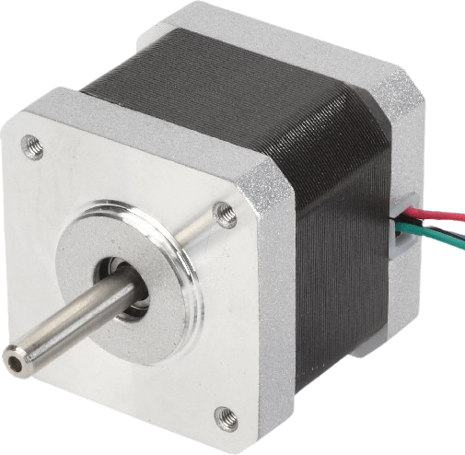
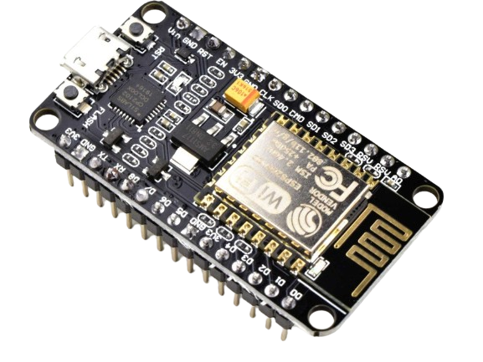
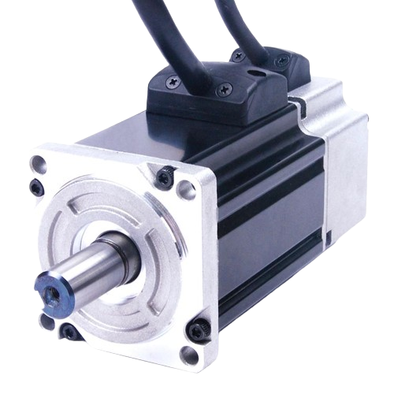

Tools

Slide 44
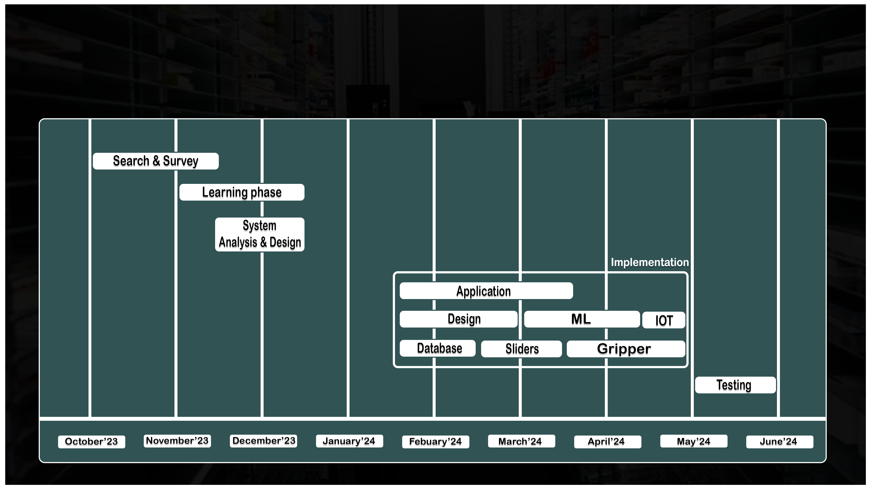
Time plan

Slide 45
References
Introduction:
Pharmacy Automation: The Ultimate Guide to Automating Your Pharmacy (pharmacymentor.com)
Problem Statement:
Cause of Death: Sloppy Doctors - TIME
Related Works:
(2952) Smart Pharmacy | الصيدلية الذكية – YouTube
(2952) صيدلية إلكترونية ونظارة للمكفوفين.. مشروعات تخرج لطلاب جامعة كفر الشيخ باستخدام "الذكاء الاصطناعي" - YouTube
Grippers:
Robotic gripper with worm gears | 3D CAD Model Library | GrabCAD
Robot Servo Motor Gripper | 3D CAD Model Library | GrabCAD
Sliders:
Schematic diagram of a vertical ball screw feed system. | Download Scientific Diagram (researchgate.net)
Linear Actuator/Slide Belt Driven | 3D CAD Model Library | GrabCAD

Slide 46
Thanks!

